Slide 1
Query by Humming Searching Sep 2rd
Jiarui Xu(Jerry), Alexander Lerch

Slide 2

Shazam
Start from Shazam’s algorithm(SoundHound), because SoundHound is simpler than Humming Query, so I start from this and then go to QBH.

Slide 3
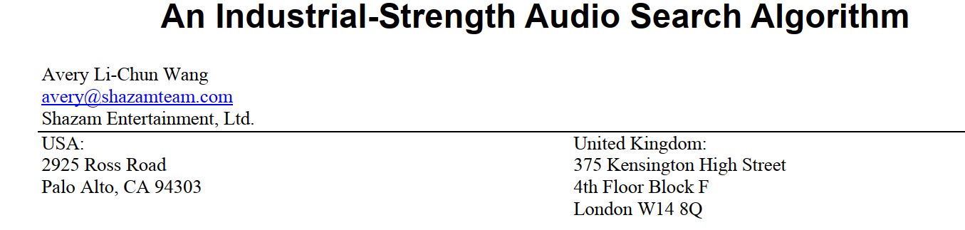
Paper1

Slide 4
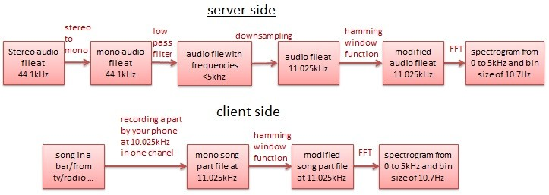
Shazam schematic diagram

Slide 5
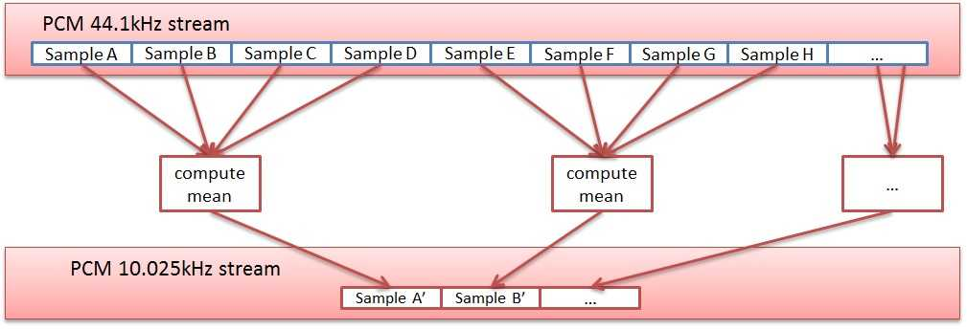
Methods used(What I understand)
Downsampling: maintain high signal-noise rate
Hamming window: avoid spectral leakage
As DFT is slow, instead, the system uses FFT(odd and even)
Pulse Coded Modulation（PCM）

Slide 6
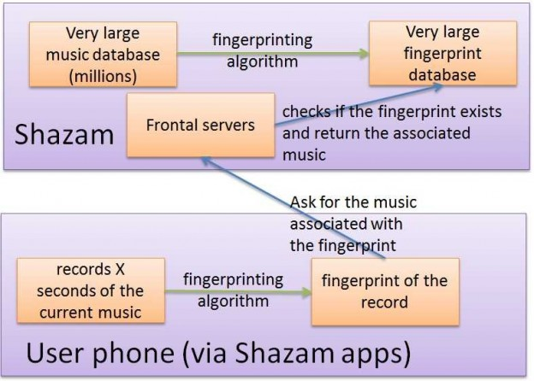
Shazam schematic diagram

Slide 7
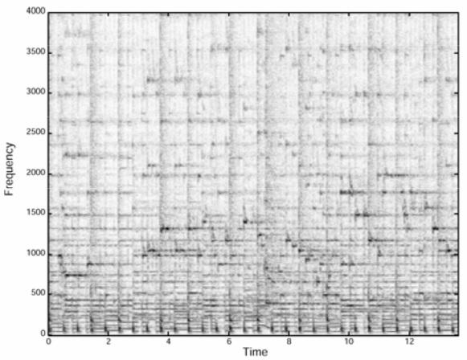
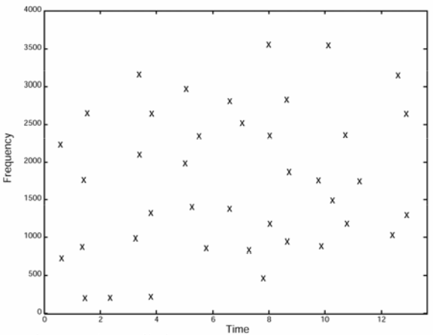
Some details
only the loudest notes are kept
audio fingerprinting(like a bar code or QR code) algorithms uses the spectrogram of audio signals to extract fingerprints

Slide 8
Problems
1. the Shazam fingerprinting algorithm works only with frequencies
fingerprints needs to be time invariant
fingerprint matching need to be fast
2. The human ear perceives music logarithmically, (Human ears have more difficulties to hear a low sound (<500Hz) than a mid-sound (500Hz-2000Hz) or a high sound (>2000Hz). As a result low sounds of many “raw” songs are artificially increased before being released.
3. spectral leakage
4.being Noise/Fault tolerant
because the music recorded by a phone in a bar/outdoor has a bad quality,
because of the artifact due to window functions,
because of the cheap microphone inside a phone that produces noise/distortion
because of many physical stuff

Slide 9
Next several weeks
Implement soundHound in a virtual environment through code.
Learn how to generate fingerprints, and think about how to apply fingerprints to humming.
Explore whether a new form of 'fingerprint' is needed to correspond to humming.

Slide 10
Thank you!

